Slide 1
Initial Matting-Guided Visual Tracking With Siamese Network XIAOFEI QIN, ZEPEI FAN Shanghai Key Laboratory of Contemporary Optics System, University of Shanghai for Science and Technology
Published in IEEE Access on March 26, 2019
Presented by-
Md. Maklachur Rahman School of Computer Science and Engineering
Kyungpook National University
Daegu, South Korea

Slide 2
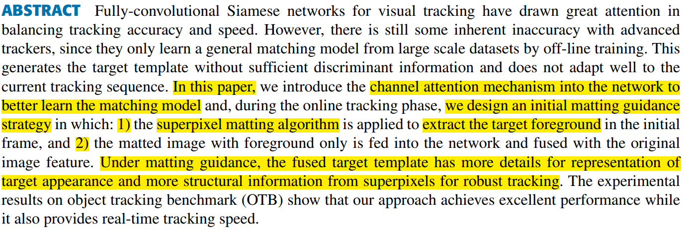
ABSTRACT
In this paper, they introduce the channel attention mechanism into the network to learn the better matching model.
During the tracking phase, they design an initial matting guidance strategy where,
The super-pixel matting algorithm is applied to extract the target foreground in the initial frame, and
The matted image with foreground only is fed into the network and fused with the original image feature.
The fused target template has more details for representation of target appearance and more structural information from super-pixels for robust tracking.

Slide 3
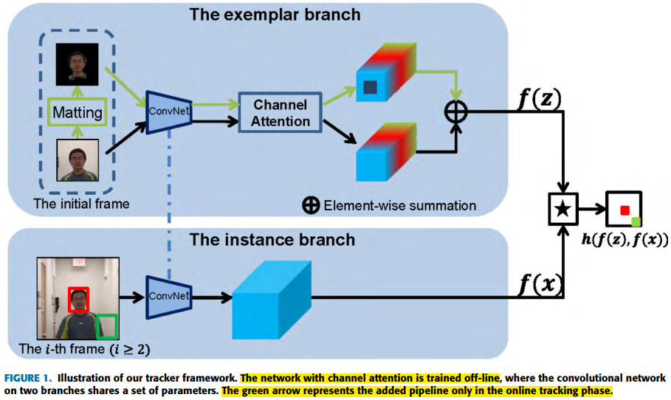
Architecture of the tracker
These two features (from matted image and initial image) with the same number of channels are element-wise fused by a weight
where F^{M} and F^{O} represent the matted image feature and original image feature respectively.
The fused features not only preserve the global information from the original image, but also increase the detail and structure information from the matted image.

Slide 4
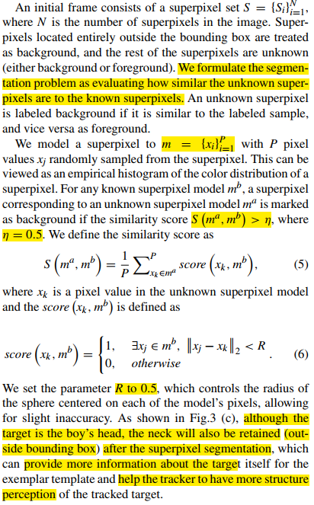
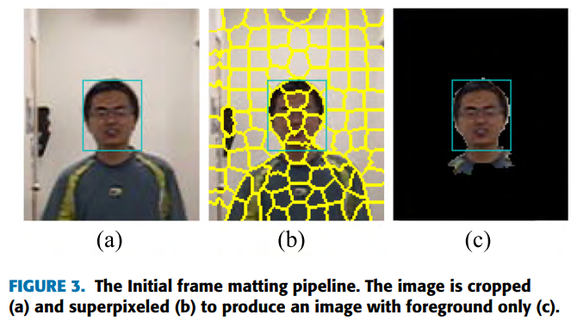
Initial frame matting process
They find that adding only the attention model into the network did not significantly improve performance.
The initial frame has a significant influence on the tracking results.
Therefore, super pixel based matting process in the initial frame not only help to capture color and texture, but also retain the target’s structural information.

Slide 5
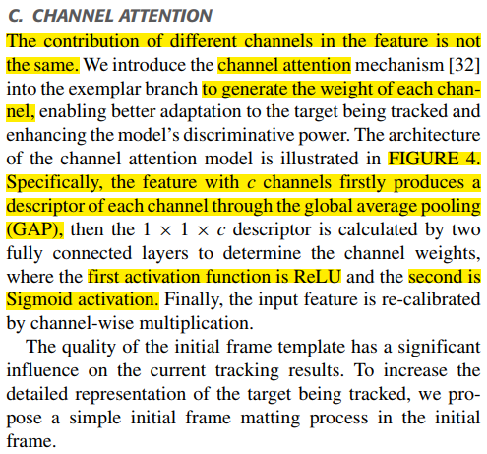
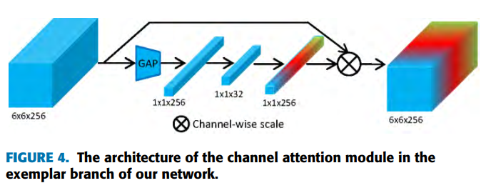
Channel attention
The contribution of every channels in the feature is not the same.
In addition, the channel attention mechanism generates a descriptor of the priority and weight for each feature channel.
Enabling better adaptation to the target being tracked and enhancing the model’s discriminative power.

Slide 6
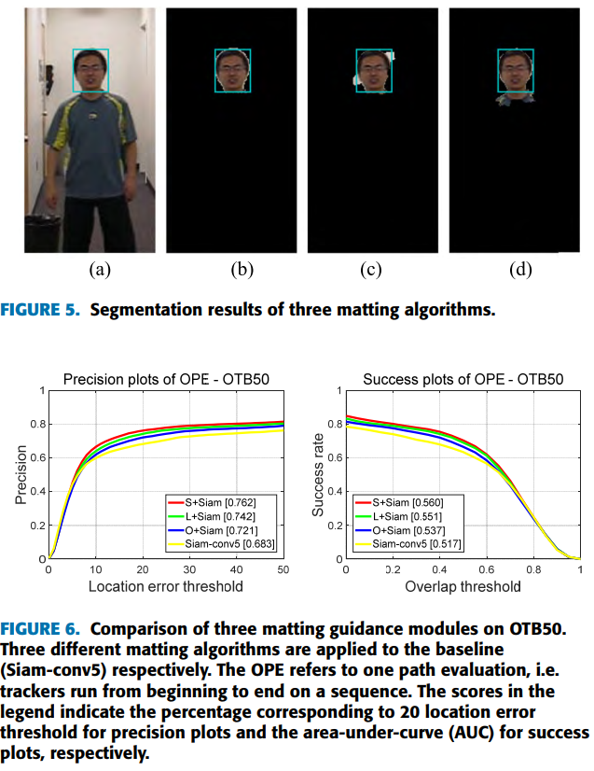
Matting process selection
They experiments on three types of matting process.
LBDM = Learning Based Digital Matting
OC-SVM = One-Class SVM
SBBM = Sampled-Based Background Model
LBDM shows the best segmentation of among three but it does not achieve the best tracking performance, most likely because of over-fitting caused by high segmentation accuracy.
Selection of matting algorithm directly affect the performance of the proposed tracker.

Slide 7
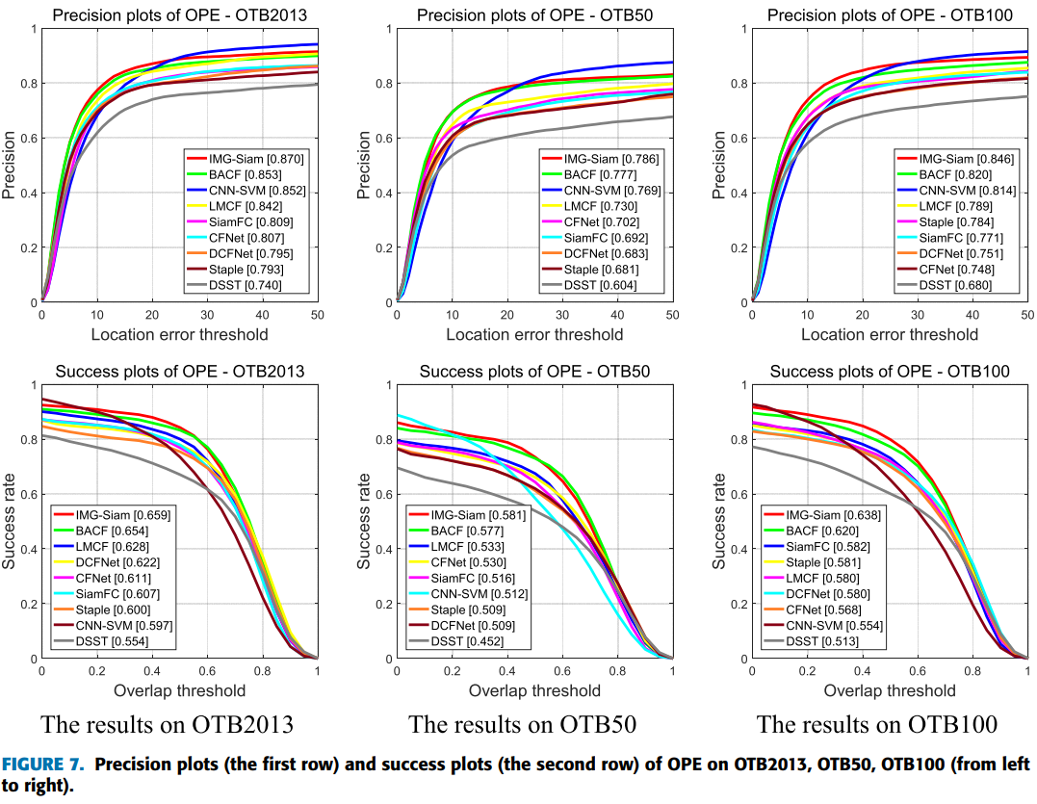
Performance comparison of different trackers

Slide 8
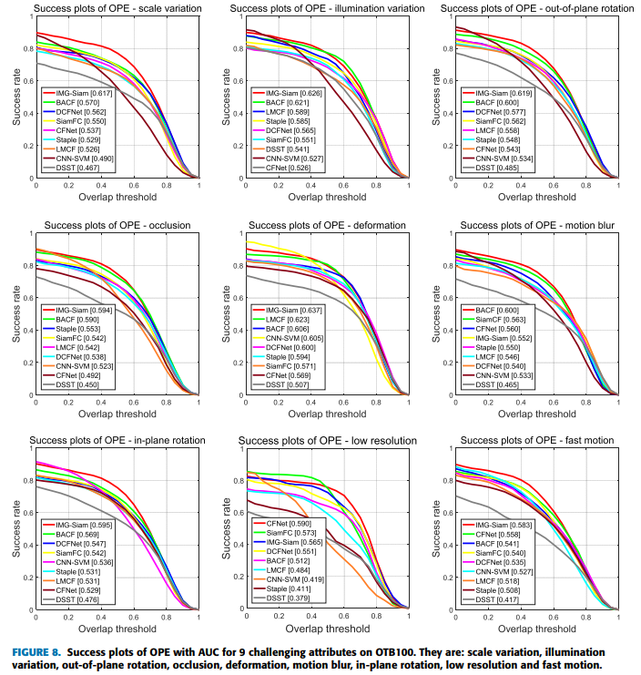
Success plots of several challenging sequences from OTB100

Slide 9
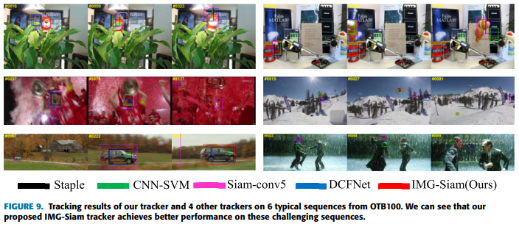
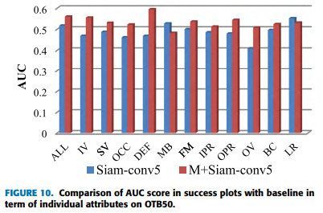
Performance and comparison

Slide 10
Conclusion
The channel attention module provides enhanced target adaptation (in different challenging situation) while the matting guidance module improves template construction (by superpixels being able to retain texture and color information of an image patch and also capture structural information of the whole target for robust tracking).
Also, they find that only adding the attention model or matting into the network did not significantly improve performance.
They choose the superpixel algorithm to apply the initial matting through the comparison from three segmentation methods.
Experiments on OTB2013, OTB50 and OTB100 show that the proposed tracker achieves 87.0%, 78.6% and 84.6% precision, respectively, and achieves a speed of 50 frames per second on GPU.

Slide 11
감사합니다 (Thank you) Q&A

